Slide 1

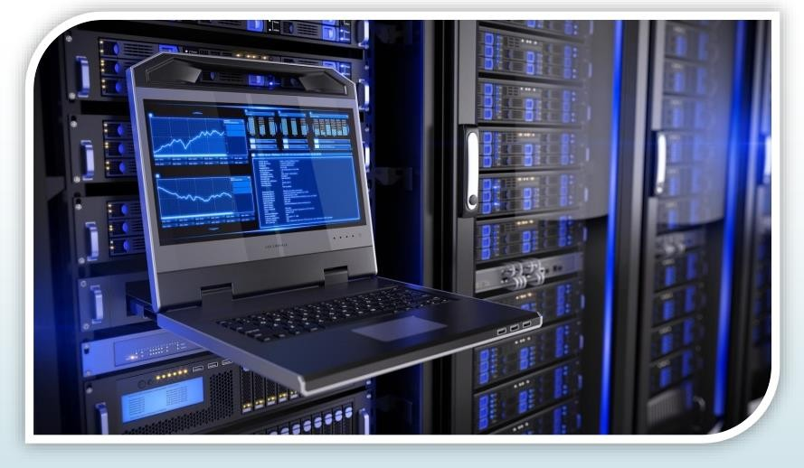
Chapter 1
Computers
Computer Architecture & Organization

Slide 2

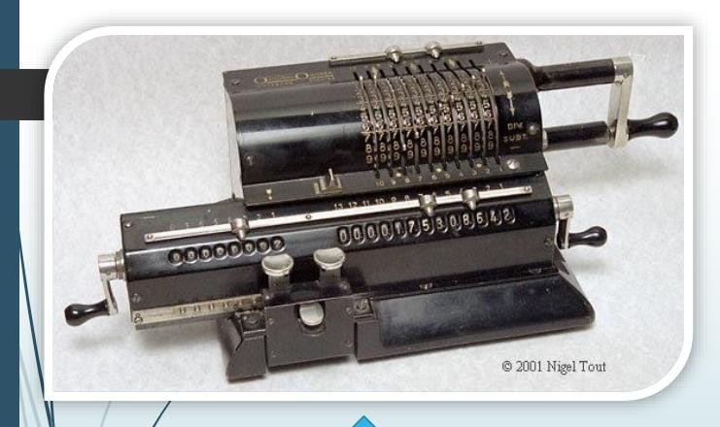

Did You Know?
🠶 The computers we see today, were not always the same.
🠶 By computers, it mean anything that is able or helpful in computing.
🠶 Early computers were mechanical calculators, punching machines etc.
🠶 Then came ENIAC etc. that digitally computed but were too big.
🠶 The usage of personal computers started as a hobby among a certain set of people and went on to become something that people
cannot live without.
1935: Odhner Circa was developed. This was among the first computers used by mathematicians.

Slide 3
COMPUTER MEANS
C : Commonly O : Operator
M : Machine
P: Particular U: User
T :Trade
E : Education R: Research

Slide 4
COMPUTER GENERATIONS
🠶 The First Generation: 1940s–1950s
🠶 The Vacuum Tube Years
🠶 The Second Generation: 1950s–1960s
🠶 The Era of the Transistor
🠶 The Third Generation: 1960s–1970s
🠶 Integrated Circuits - Miniaturizing the Computer
🠶 The Fourth Generation: 1970s–Present
🠶 The Microprocessor
🠶 Fifth Generation (Present and Beyond)
🠶 Artificial Intelligence (AI)

Slide 5
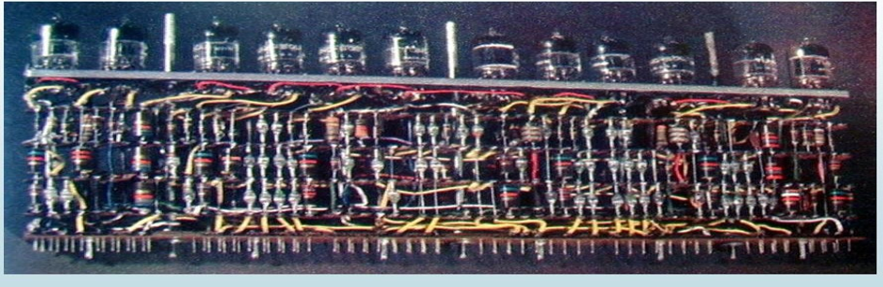
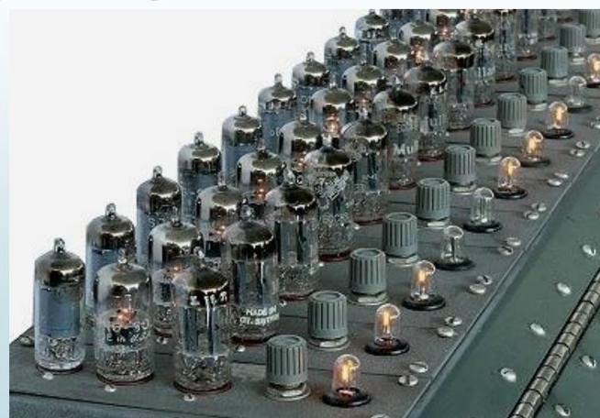
The 1 st Generation: 1940s–1950s (The Vacuum Tube Years)

Slide 6
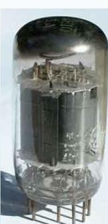
The 1 st Generation: 1940s–1950s (The Vacuum Tube Years)
🠶 Huge, slow, expensive, and undependable
🠶 electronic computers using the vacuum tubes instead of the mechanical switches
🠶 Used thousands of vacuum tubes , which
took up a lot of space
🠶 Works similarly like light bulbs
🠶 produce heat just like light bulbs do.

Slide 7

The 1 st Generation: 1940s–1950s (The Vacuum Tube Years)
Technology: Used vacuum tubes for circuitry.
Characteristics: Large size, high heat generation, and frequent malfunctions.

Slide 8
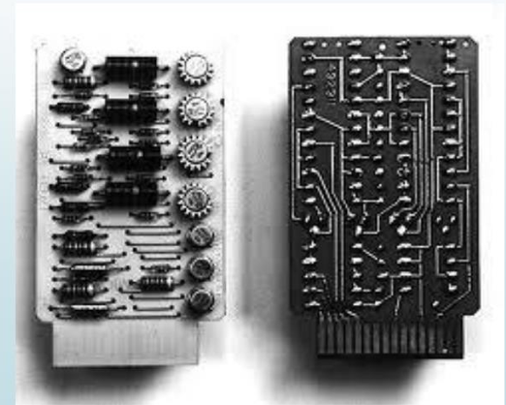
The 2nd Generation: 1950s–1960s (The Era of the Transistor)
Technology: Replaced vacuum tubes with transistors.
Characteristics: Smaller, faster, more reliable, and more energy-efficient than first-generation machines

Slide 9
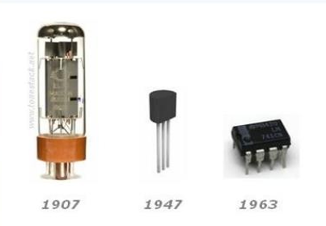
The 2nd Generation: 1950s–1960s (The Era of the Transistor)
Smaller : one transistor replaced the equivalent of 40 vacuum tubes.
Cheaper : due to the abundant and easily found materials used
Silicon (found in sand and glass)
Faster : conduct electricity faster and better than vacuum tubes. (more calculations)
Reliable : Gave off virtually no heat compared to vacuum tubes.
MORE ENERGY EFFICIENT
ALLOWED PROGRAMMERS TO SPECIFY
INSTRUCTIONS INTO WORDS

Slide 10
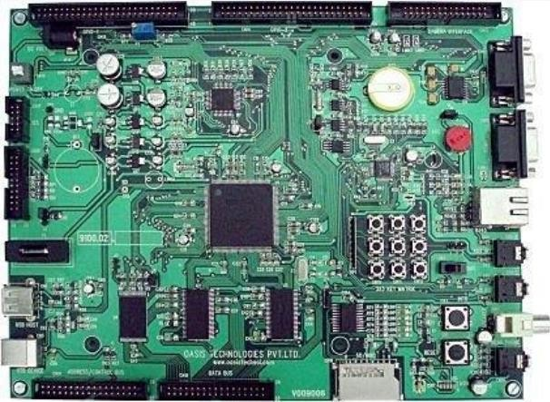
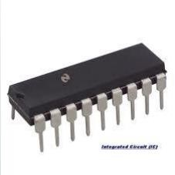
The 3rd Generation: (1960s–1970s) (Integrated Circuits - Miniaturizing the Computer)
Technology: Utilized integrated circuits (microchips), which housed many transistors on a single chip.
Characteristics: Further reduction in size and cost, increased speed and memory capacity.

Slide 11
The 3rd Generation: (1960s–1970s) (Integrated Circuits - Miniaturizing the Computer)
🠶 could carry out billionth of instructions per second
🠶 number of transistors that can be placed on a single chip double every two years
🠶 Ultimately shrink
🠶 Size of computers;
🠶 cost of computers; and
🠶 further enhancing its power(process time).

Slide 12
The 3rd Generation: (1960s–1970s) (Integrated Circuits - Miniaturizing the Computer)
🠶 The concept of integrated circuits is applied onto most of modern devices -- on printed circuit boards
🠶 thin pieces of bakelite or fiberglass
🠶 have electrical connections etched onto them
🠶 Called a mother board .

Slide 13
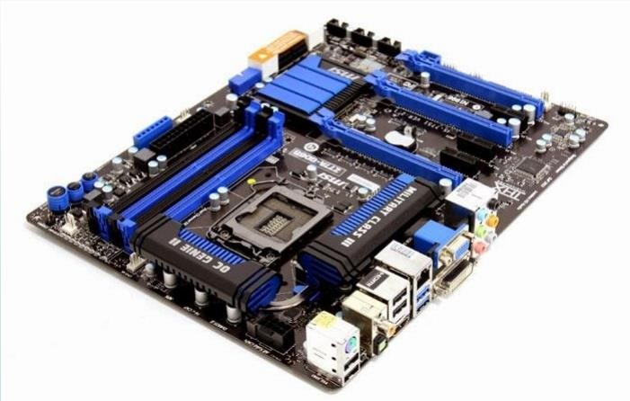
The 3 rd generation
🠶 Mother Board .

Slide 14
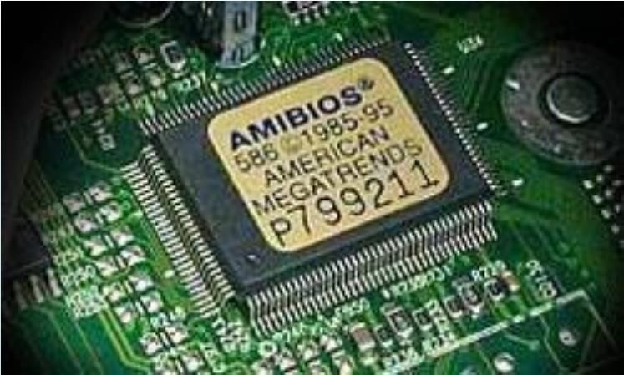
The 4 th Generation: (1970s–Present) (The Microprocessor)
Technology: The development of the microprocessor, which integrated the entire central processing unit (CPU) onto a single chip.
Characteristics: Led to the creation of microcomputers, making computers smaller, more powerful, and affordable for a wider range of users.

Slide 15
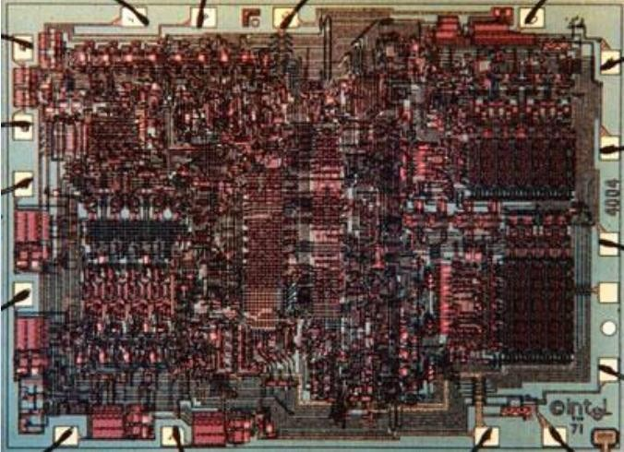
First Microprocessor
🠶 Intel 4004 (1971)
🠶 Application: calculators
🠶 Technology: 10000 nm
🠶 2300 transistors
🠶 13 mm 2
🠶 108 KHz
🠶 12 Volts
🠶 4-bit data
🠶 Single-cycle datapath

Slide 16
The 4 th Generation
🠶 By putting millions of transistors onto one single chip :
🠶 more calculation ; and
🠶 faster speeds could be reached by computers.
🠶 Because electricity travels about a foot in a billionth of a second
🠶 the smaller the distance the greater the speed of computers.
🠶 Led to the invention of personal computers or microcomputers

Slide 17
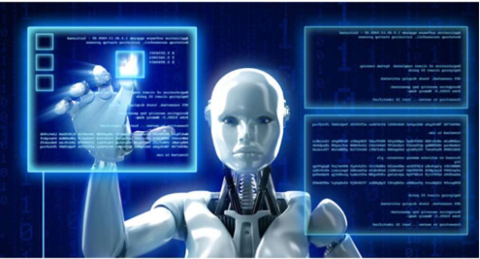
The 5 th Generation: (Present and Beyond) (Artificial Intelligence (AI)
Technology: Focuses on artificial intelligence, parallel processing, and natural language processing.
Characteristics: Developing "smart" machines with the ability to learn, reason, and understand.

Slide 18
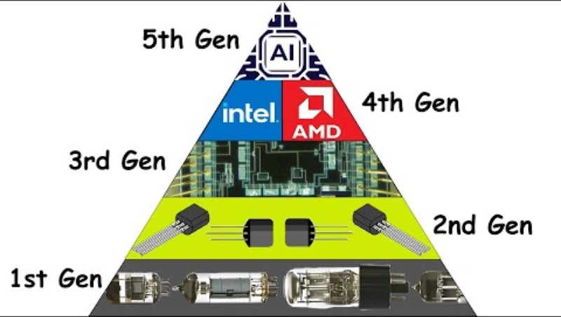
Video

Slide 19
Why Study Computer?
🠶 Enable better systems : make computers faster, cheaper, smaller, more reliable, …
🠶 By exploiting advances and changes in underlying technology/circuits
🠶 Enable new applications
🠶 Life-like 3D visualization 20 years ago? Virtual reality?
🠶 Self-driving cars?
🠶 Personalized genomics? Personalized medicine?
🠶 Enable better solutions to problems
🠶 Software innovation is built on trends and changes in computer architecture
🠶 > 50% performance improvement per year has enabled this innovation
🠶 Understand why computers work the way they do

Slide 20
Functions
🠶 There are four basic functions that a computer can perform:
🠶 Data processing
🠶 Data may take a wide variety of forms and the range of processing requirements is broad
🠶 Data storage
🠶 Short-term
🠶 Long-term
🠶 Data movement
🠶 Input-output (I/O) - when data are received from or delivered to a device (peripheral)
that is directly connected to the computer
🠶 Data communications – when data are moved over longer distances, to or from a remote device
🠶 Control
🠶 A control unit manages the computer’s resources and orchestrates the performance of its functional parts in response to instructions

Slide 21
There are four main structural components of the computer:
CPU – controls the operation of the computer and performs its data processing functions
Main Memory – stores data
I/O – moves data between the computer and its external environment
System Interconnection – some mechanism that provides for communication among CPU, main memory, and I/O

Slide 22
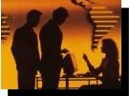
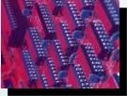
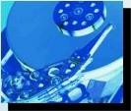
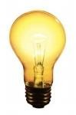
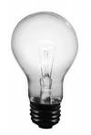
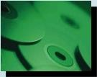
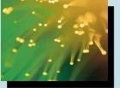
Binary Digits (Bits)
}
}
}
On 1
Off 0
Human readable symbols
Inside the
Only 2 states possible
Electronic Electronic
pulse present
Positive magnetic field
pulse absent
Negative magnetic
field
Not Pitted
computer’s
memory (RAM)
Permanently stored on disks
}
}
Permanently stored on CD-ROM
Fiber Optic Cable
On
Off
Pitted
Light Pulse
No Light Pulse

Slide 23
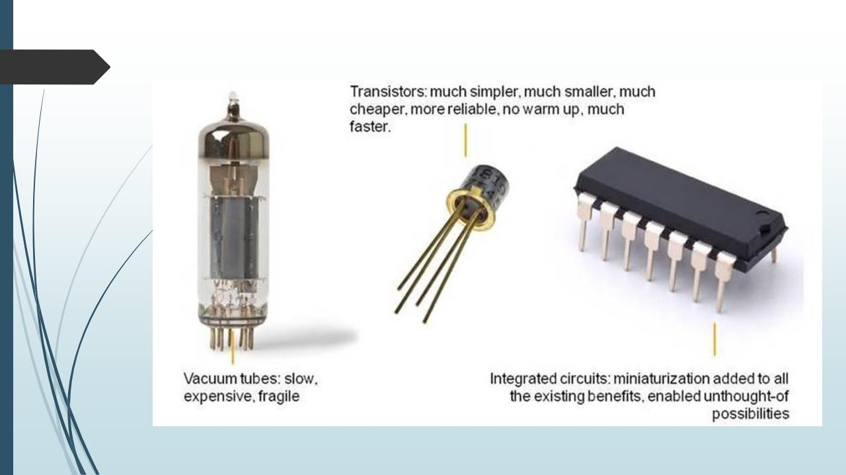
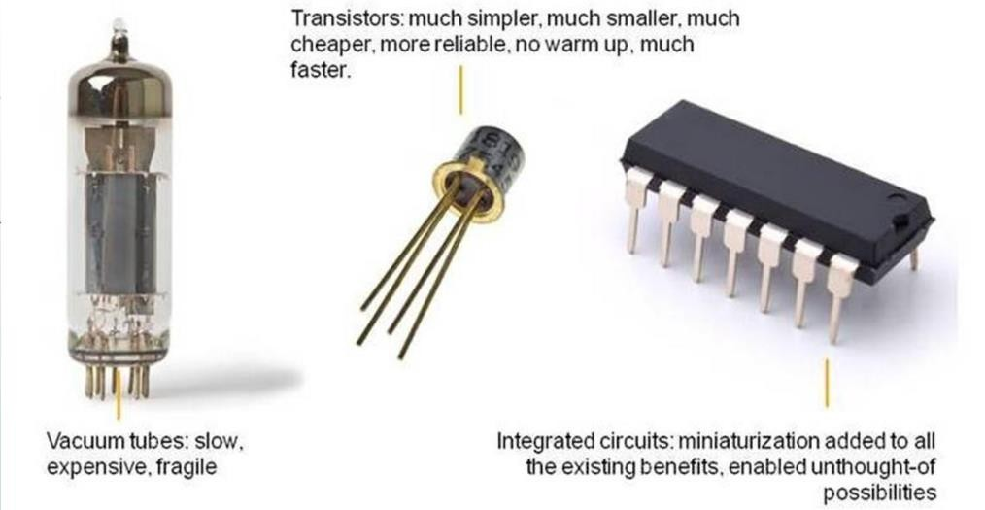

Slide 24
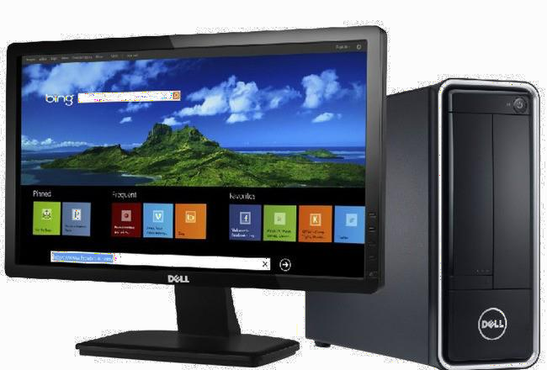


Discussion: What is the difference between
the computing industry and the
paper towel industry?

Slide 25





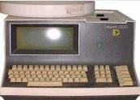
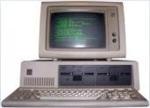
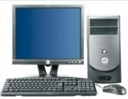
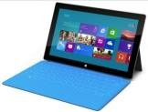
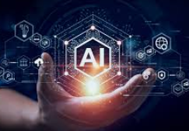
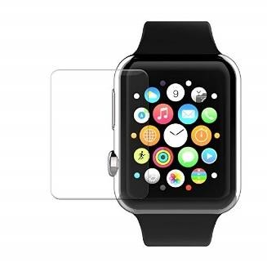
Industry of replacement
1971
2025
?
Industry of new possibilities

Slide 26
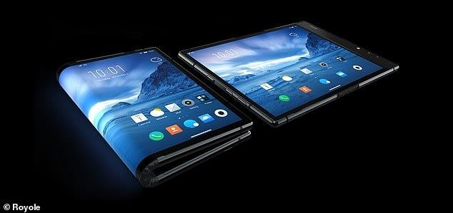
Can we continue being an industry of new possibilities?

Slide 27
THANK YOU

